Slide 1
Motivating Employees

Slide 2
Learning Objective
  Explain how goal-setting and reinforcement theories explain employee motivation.
  Describe job design approaches to motivation.
  Discuss the motivation implications of equity theory.
  Explain the three key linkages in expectancy theory and their role in motivation.

Slide 3
Learning Outcomes
Current Issues in Motivation
  Describe the cross-cultural challenges of motivation.
  Discuss the challenges managers face in motivating unique groups of workers.
  Describe open-book management, employee recognition, pay-for-performance, and stock option programs.

Slide 4
What is Motivation?
Motivation
  Is the result of an interaction between the person and a situation; Is it a personal trait?
  Is the process by which a person’s efforts are energized, directed, and sustained towards attaining a goal.
    Energy: a measure of intensity or drive.
    Direction: toward organizational goals
    Persistence: exerting effort to achieve goals.
  Motivation works best when individual needs are compatible with organizational goals.

Slide 5
Early Theories of Motivation
Maslow’s Hierarchy of Needs
McGregor’s Theories X and Y
Herzberg’s Two-Factor Theory
McClelland’s Three Needs Theory

Slide 6
Early Theories of Motivation
Maslow’s Hierarchy of Needs Theory
  Abraham Maslow first introduced the concept of a hierarchy of needs in his 1943 paper, titled "A Theory of Human Motivation," and again in his subsequent book, "Motivation and Personality." This hierarchy suggests that people are motivated to fulfill basic needs before moving on to other, more advanced needs.
  Maslow’s hierarchy of needs is a motivational theory in psychology comprising a five-tier model of human needs, often depicted as hierarchical levels within a pyramid.

Slide 7
Early Theories of Motivation
Maslow’s Hierarchy of Needs Theory
  As a humanist, Maslow believed that people have an inborn desire to be self-actualized, that is, to be all they can be.
  To achieve this ultimate goal, however, a number of more basic needs must be met.
  This includes the need for food, safety, love, and self-esteem.
  Maslow’s hierarchy of needs is a motivational theory in psychology comprising a five-tier model of human needs, often depicted as hierarchical levels within a pyramid.

Slide 8
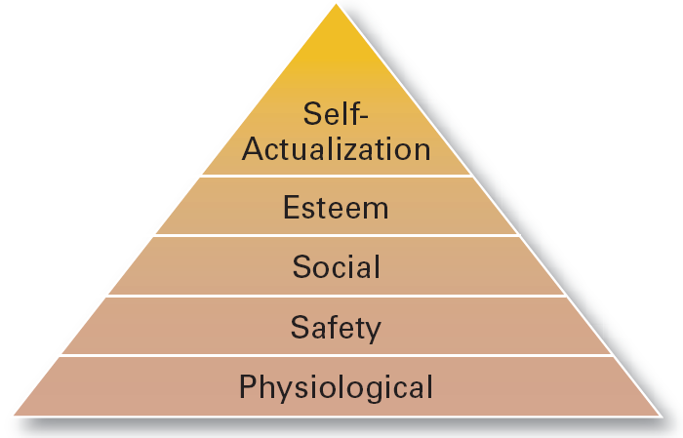
Maslow’s Hierarchy of Needs

Slide 9
Early Theories of Motivation
Maslow’s Hierarchy of Needs Theory
  Needs were categorized as five levels of lower- to higher-order needs.
    Individuals must satisfy lower-order needs before they can satisfy higher order needs.
    Satisfied needs will no longer motivate.
    Motivating a person depends on knowing at what level that person is on the hierarchy.
  Hierarchy of needs
    Lower-order (external): physiological, safety
    Higher-order (internal): social, esteem, self-actualization

Slide 10
Early Theories of Motivation
Physiological needs:
  Food, shelter, clothing, water, homeostasis, etc.,
Safety / Security needs:
  Financial security, health, wellness, safety against accidents and injury
Social
  Friendships, Family, Relationships, community groups, etc.,
Esteem
  Need for appreciation and respect
Self-actualization
  Self-aware, concerned with personal growth, less concerned with the opinions of others, and interested in fulfilling their potential.

Slide 11
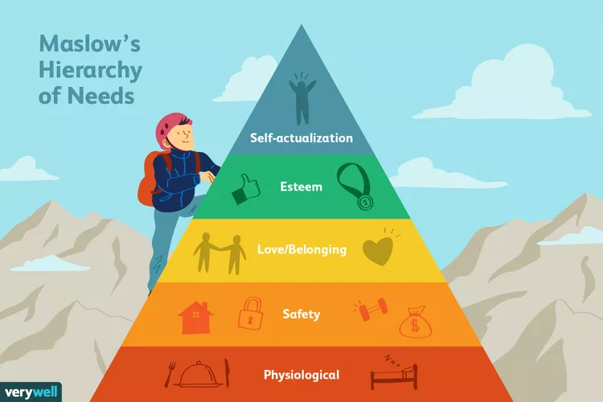
Early Theories of Motivation

Slide 12
Early Theories of Motivation
McGregor’s Theory X and Theory Y
  The idea that a manager’s attitude has an impact on employee motivation was originally proposed by Douglas McGregor, a management professor at the Massachusetts Institute of Technology during the 1950s and 1960s.
  In his 1960 book, The Human Side of Enterprise, McGregor proposed two theories by which managers perceive and address employee motivation.
  He referred to these opposing motivational methods as Theory X and Theory Y management.
  Each assumes that the manager’s role is to organize resources, including people, to best benefit the company. However, beyond this commonality, the attitudes and assumptions they embody are quite different.

Slide 13
Early Theories of Motivation
McGregor’s Theory X
  Work is inherently distasteful to most people, and they will attempt to avoid work whenever possible.
  Most people are not ambitious, have little desire for responsibility, and prefer to be directed.
  Most people have little aptitude for creativity in solving organizational problems.
  Motivation occurs only at the physiological and security levels of Maslow’s hierarchy of needs.
  Most people are self-centered. As a result, they must be closely controlled and often coerced to achieve organizational objectives.
  Most people resist change.
  Most people are gullible and unintelligent.

Slide 14
Early Theories of Motivation
McGregor’s Theory Y
  Work can be as natural as play if the conditions are favorable.
  People will be self-directed and creative to meet their work and organizational objectives if they are committed to them.
  People will be committed to their quality and productivity objectives if rewards are in place that address higher needs such as self-fulfillment.
  The capacity for creativity spreads throughout organizations.
  Most people can handle responsibility because creativity and ingenuity are common in the population.
  Under these conditions, people will seek responsibility.

Slide 15
Early Theories of Motivation (cont’d)
McGregor’s Theory X and Theory Y
  Theory X
    Assumes that workers have little ambition, dislike work, avoid responsibility, and require close supervision.
  Theory Y
    Assumes that workers can exercise self-direction, desire responsibility, and like to work.
  Assumption:
    Motivation is maximized by participative decision making, interesting jobs, and good group relations.

Slide 16
Early Theories of Motivation
Herzberg’s Motivation-Hygiene Theory
  Herzberg's motivation-hygiene theory states that certain elements within a workplace lead to job satisfaction, while others lead to dissatisfaction.
  Herzberg and his team investigated several factors relating to job satisfaction in their original study, classifying them as either hygienic or motivational factors. Motivation factors increase job satisfaction, while hygiene factors prevent job dissatisfaction.
    Hygiene factors: extrinsic (environmental) factors that create job dissatisfaction.
    Motivators: intrinsic (psychological) factors that create job satisfaction.

Slide 17
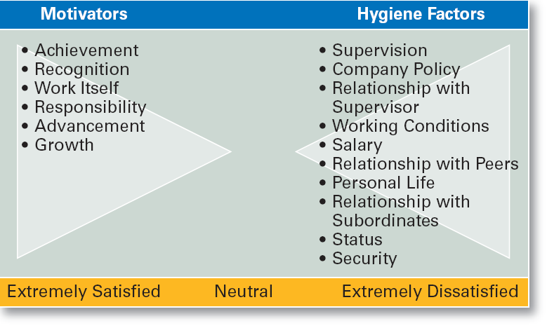
Herzberg’s Motivation-Hygiene Theory

Slide 18
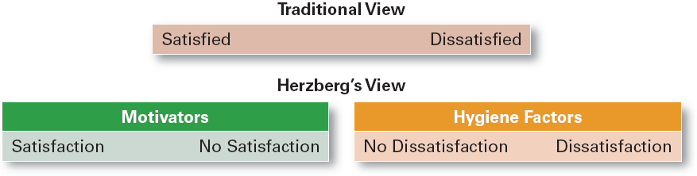
Contrasting Views of Satisfaction- Dissatisfaction

Slide 19
Motivation and Needs
Three-Needs Theory (McClelland)
  Psychologist David McClelland’s needs theory splits the needs of employees into three categories. These three categories are achievement, affiliation, and power.
    Need for achievement (nAch)
      The drive to excel and succeed
    Need for power (nPow)
      The need to influence the behavior of others
    Need of affiliation (nAff)
      The desire for interpersonal relationships

Slide 20
Motivation and Needs
Three-Needs Theory (McClelland)
  Need for achievement (nAch)
  Employees who are strongly achievement-motivated are driven by the desire for mastery.
  They prefer working on tasks of moderate difficulty in which outcomes are the result of their effort rather than luck.
  They value receiving feedback on their work.

Slide 21
Motivation and Needs
Three-Needs Theory (McClelland)
  Need of affiliation (nAff)
  Employees who are strongly affiliation-motivated are driven by the desire to create and maintain social relationships.
  They enjoy belonging to a group and want to feel loved and accepted.
  They may not make effective managers because they may worry too much about how others will feel about them.

Slide 22
Motivation and Needs
Three-Needs Theory (McClelland)
  Need of power (nPow)
  Employees who are strongly power-motivated are driven by the desire to influence, teach, or encourage others.
  They enjoy work and place a high value on discipline.
  However, they may take a zero-sum approach to group work—for one person to win, or succeed, another must lose, or fail.
  If channeled appropriately, though, this can positively support group goals and help others in the group feel competent.

Slide 23
Motivation and Needs
Three-Needs Theory (McClelland)
  This theory doesn’t claim that people can be neatly categorized into one of three types.
  Rather, it asserts that all people are motivated by all of these needs in varying degrees and proportions.
  An individual’s balance of these needs forms a kind of profile that can be useful in creating a tailored motivational paradigm for her.
  It is important to note that needs do not necessarily correlate with competencies; it is possible for an employee to be strongly affiliation-motivated, for example, but still be successful in a situation in which her affiliation needs are not met.

Slide 24
Motivation and Needs
Three-Needs Theory (McClelland)
  McClelland proposes that those in top management positions generally have a high need for power and a low need for affiliation.
  He also believes that although individuals with a need for achievement can make good managers, they are not generally suited to being in top management positions.

Slide 25
Contemporary Theories of Motivation
Goal-Setting Theory
Reinforcement Theory
Designing Motivating Jobs
Equity Theory
Expectancy Theory

Slide 26
Motivation and Goals
Goal-Setting Theory
  Published in 1968 by American psychologist, Dr. Edwin A. Locke.
  The theory states that clear, well-defined, and measurable goals improve performance much more than vague objectives do.

Slide 27
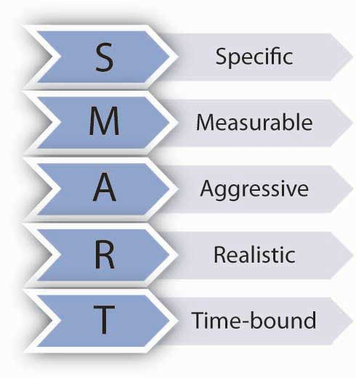
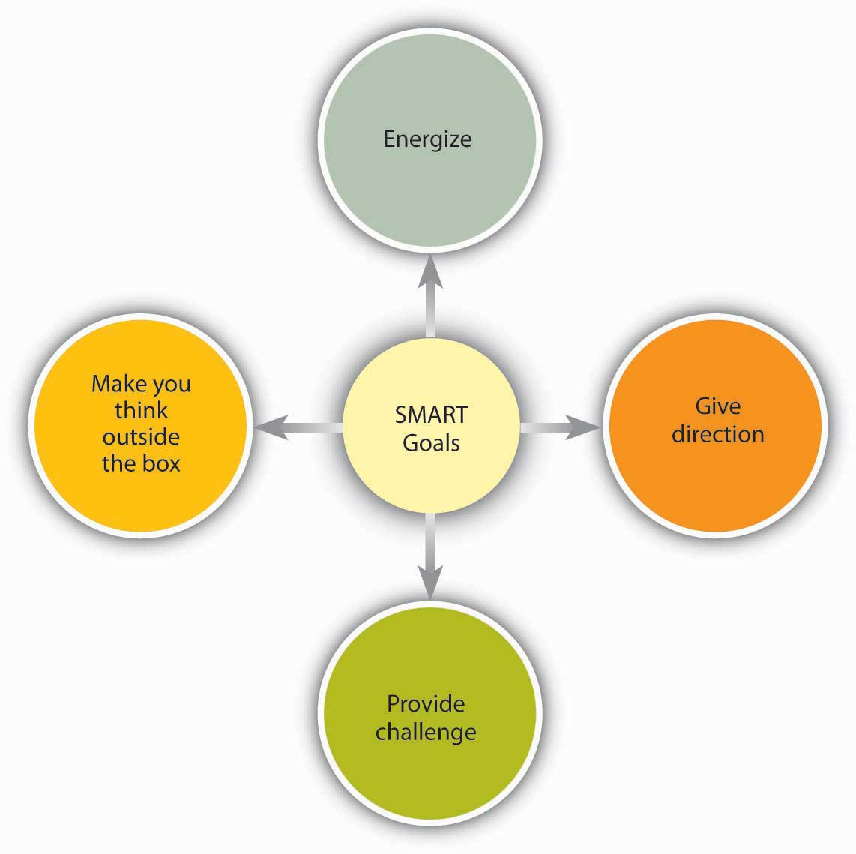
Motivation and Goals
Goal-Setting Theory
  SMART goals help people achieve results.

Slide 28
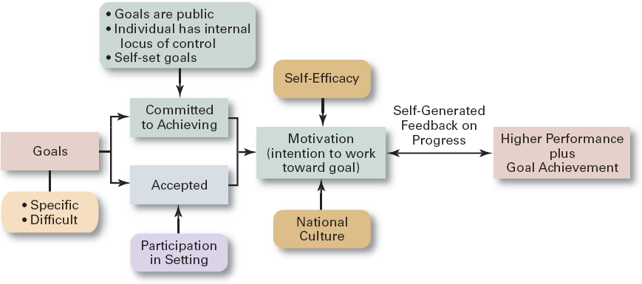
Goal-Setting Theory

Slide 29
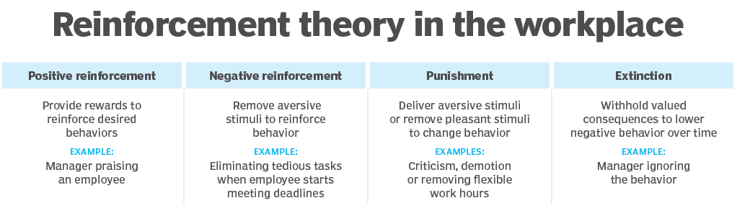
Motivation and Behavior
Reinforcement Theory
  Reinforcement theory is a psychological principle suggesting that behaviors are shaped by their consequences, and that individual behaviors can be changed through reinforcement, punishment and extinction.

Slide 30
Designing Motivating Jobs
Job Design
  The way into which tasks can be combined to form complete jobs.
  Factors influencing job design:
    Changing organizational environment/structure
    The organization’s technology
    Employees’ skill, abilities, and preferences
  Job enlargement
    Increasing the job’s scope (number and frequency of tasks)
  Job enrichment
    Increasing responsibility and autonomy (depth) in a job.

Slide 31
Designing Motivating Jobs (cont’d)
Job Characteristics Model (JCM)
  A conceptual framework for designing motivating jobs that create meaningful work experiences that satisfy employees’ growth needs.
  Five primary job characteristics:
    Skill variety: how many skills and talents are needed?
    Task identity: does the job produce a complete work?
    Task significance: how important is the job?
    Autonomy: how much independence does the jobholder have?
    Feedback: do workers know how well they are doing?

Slide 32
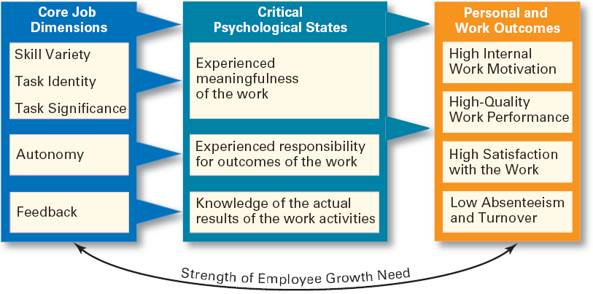
Job Characteristics Model

Slide 33
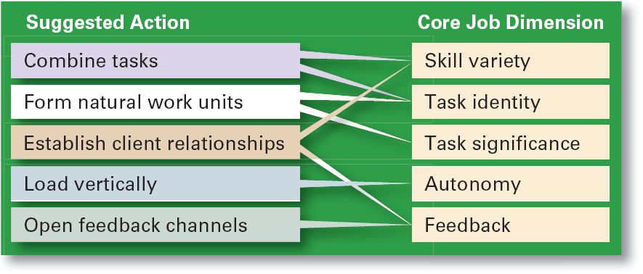
Guidelines for Job Redesign

Slide 34
Designing Motivating Jobs (cont’d)
Suggestions for Using the JCM
  Combine tasks (job enlargement) to create more meaningful work.
  Create natural work units to make employees’ work important and whole.
  Establish external and internal client relationships to provide feedback.
  Expand jobs vertically (job enrichment) by giving employees more autonomy.
  Open feedback channels to let employees know how well they are doing.

Slide 35
Equity Theory
  Proposes that employees perceive what they get from a job situation (outcomes) in relation to what they put in (inputs) and then compare their inputs-outcomes ratio with the inputs-outcomes ratios of relevant others.
    If the ratios are perceived as equal then a state of equity (fairness) exists.
    If the ratios are perceived as unequal, inequity exists and the person feels under- or over-rewarded.
    When inequities occur, employees will attempt to do something to rebalance the ratios (seek justice).

Slide 36
Equity Theory (cont’d)
  Employee responses to perceived inequities:
    Distort own or others’ ratios.
    Induce others to change their own inputs or outcomes.
    Change own inputs (increase or decrease efforts) or outcomes (seek greater rewards).
    Choose a different comparison (referent) other (person, systems, or self).
    Quit their job.
  Employees are concerned with both the absolute and relative nature of organizational rewards.

Slide 37
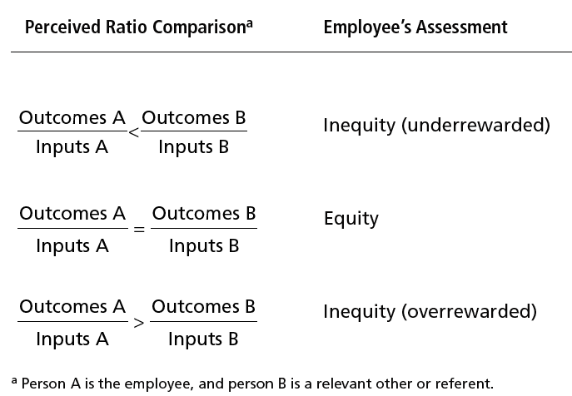
Equity Theory

Slide 38
Equity Theory (cont’d)
  Distributive justice
    The perceived fairness of the amount and allocation of rewards among individuals (i.e., who received what).
      Influences an employee’s satisfaction.
  Procedural justice
    The perceived fairness of the process use to determine the distribution of rewards (i.e., how who received what).
      Affects an employee’s organizational commitment.

Slide 39
Expectancy Theory
  States that an individual tends to act in a certain way based on the expectation that the act will be followed by a given outcome and on the attractiveness of that outcome to the individual.
  Key to the theory is understanding and managing employee goals and the linkages among and between effort, performance and rewards.
    Effort: employee abilities and training/development
    Performance: valid appraisal systems
    Rewards (goals): understanding employee needs

Slide 40
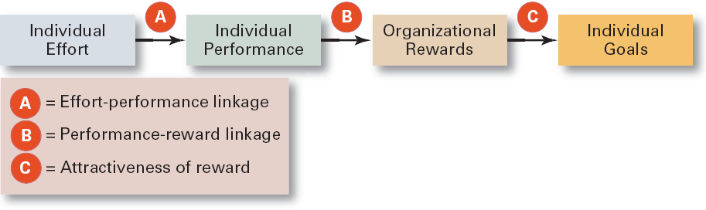
Simplified Expectancy Model

Slide 41
Expectancy Theory
Expectancy Relationships
  Expectancy (effort-performance linkage)
    The perceived probability that an individual’s effort will result in a certain level of performance.
  Instrumentality
    The perception that a particular level of performance will result in the attaining a desired outcome (reward).
  Valence
    The attractiveness/importance of the performance reward (outcome) to the individual.

Slide 42
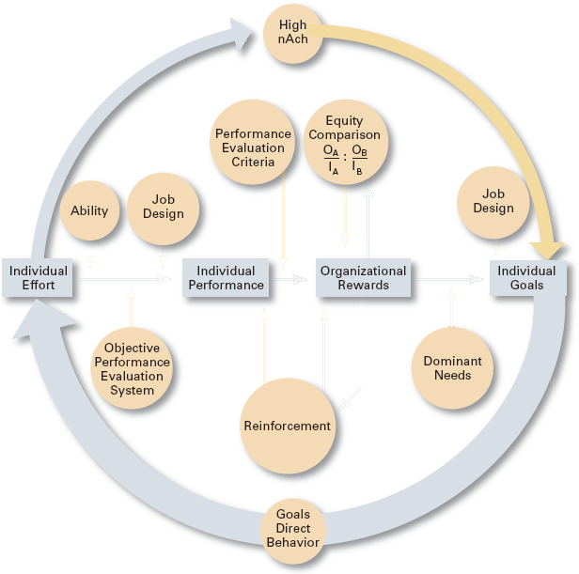
Integrating Contemporary Theories of Motivation

Slide 43
Current Issues in Motivation
Cross-Cultural Challenges
  Motivational programs are most applicable in cultures where individualism and achievement are cultural characteristics
    Uncertainty avoidance of some cultures inverts Maslow’s needs hierarchy.
    The need for achievement (nAch) is lacking in other cultures.
    Collectivist cultures view rewards as “entitlements” to be distributed based on individual needs, not individual performance.
  Cross-Cultural Consistencies
    Interesting work is widely desired, as is growth, achievement, and responsibility.

Slide 44
Motivating Unique Groups of Workers
Motivating Diverse Workforce
  Motivating a diverse workforce through flexibility:
    Men desire more autonomy than do women.
    Women desire learning opportunities, flexible work schedules, and good interpersonal relations.

Slide 45
Motivating Unique Groups of Workers
Motivating Diverse Workforce
  Compressed workweek
    Longer daily hours, but fewer days
  Flexible work hours (flextime)
    Specific weekly hours with varying arrival, departure, lunch and break times around certain core hours during which all employees must be present.
  Job Sharing
    Two or more people split a full-time job.
  Telecommuting
    Employees work from home using computer links.

Slide 46
Motivating Unique Groups of Workers
Motivating Professionals
  Characteristics of professionals
    Strong and long-term commitment to their field of expertise.
    Loyalty is to their profession, not to the employer.
    Have the need to regularly update their knowledge.
    Don’t define their workweek as 8:00 am to 5:00 pm.
  Motivators for professionals
    Job challenge
    Organizational support of their work

Slide 47
Motivating Unique Groups of Workers
Motivating Contingent Workers
  Opportunity to become a permanent employee
  Opportunity for training
  Equity in compensation and benefits
Motivating Low-Skilled, Minimum-Wage Employees
  Employee recognition programs
  Provision of sincere praise

Slide 48
Current Issues in Motivation
Designing Appropriate Rewards Programs
  Open-book management
    Involving employees in workplace decision by opening up the financial statements of the employer.
  Employee recognition programs
    Giving personal attention and expressing interest, approval, and appreciation for a job well done.
  Pay-for-performance
    Variable compensation plans that reward employees on the basis of their performance:
      Piece rates, wage incentives, profit-sharing, and lump-sum bonuses

Slide 49
Designing Appropriate Rewards Programs (cont’d)
  Stock option programs
    Using financial instruments (in lieu of monetary compensation) that give employees the right to purchase shares of company stock at a set (option) price.
    Options have value if the stock price rises above the option price; they become worthless if the stock price falls below the option price.

Slide 50
From Theory to Practice:
Guidelines for Motivating Employees
Recognize individual differences
Match people to jobs
Use goals
Ensure that goals are perceived as attainable
Individualize rewards
Link rewards to performance
Check the system for equity
Use recognition
Show care and concern for employees
Don’t ignore money

Slide 51
Terms to Know
motivation
hierarchy of needs theory
physiological needs
safety needs
social needs
esteem needs
self-actualization needs
Theory X
Theory Y
Two Factor theory
hygiene factors
motivators
three-needs theory
need for achievement (nAch)
need for power (nPow)
need for affiliation (nAff)
goal-setting theory
self-efficacy
reinforcement theory
reinforcers
job design
job scope
job enlargement

Slide 52
Test your Skills
  Define motivation.
  Explain the three key elements of motivation.
  Describe Maslow’s hierarchy of needs and how it can be used to motivate.
  Discuss how Theory X and Theory Y managers approach motivation.
  Describe Herzberg’s motivation-hygiene theory.
  Describe the three-needs theory.

Slide 53
References
Stephen P. Robbins, Coulter and Vohra , “Management” 10th edition, Pearson Publications.

